Slide 1
Tornado Analysis
By Jarvis, with help from Judy ->

Slide 2
Overview of project
Webscrape
Clean data
Machine learning
Tableau visualization & insights

Slide 3
Phase one
Web scrape – Beautiful Soup
Postgres Database & exported CSV’s
Clean data with SqlAlchemy & Pandas

Slide 4
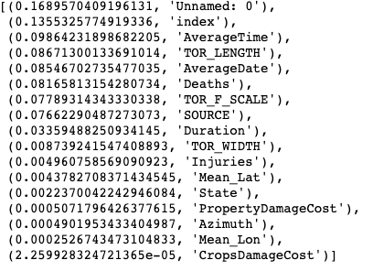
Phase two
Machine learning
Logistic regression -> Grid searching -> Random forest
Best model = .71076
Notes:
Arima Model

Slide 5
Phase Three
Tableau

Slide 6
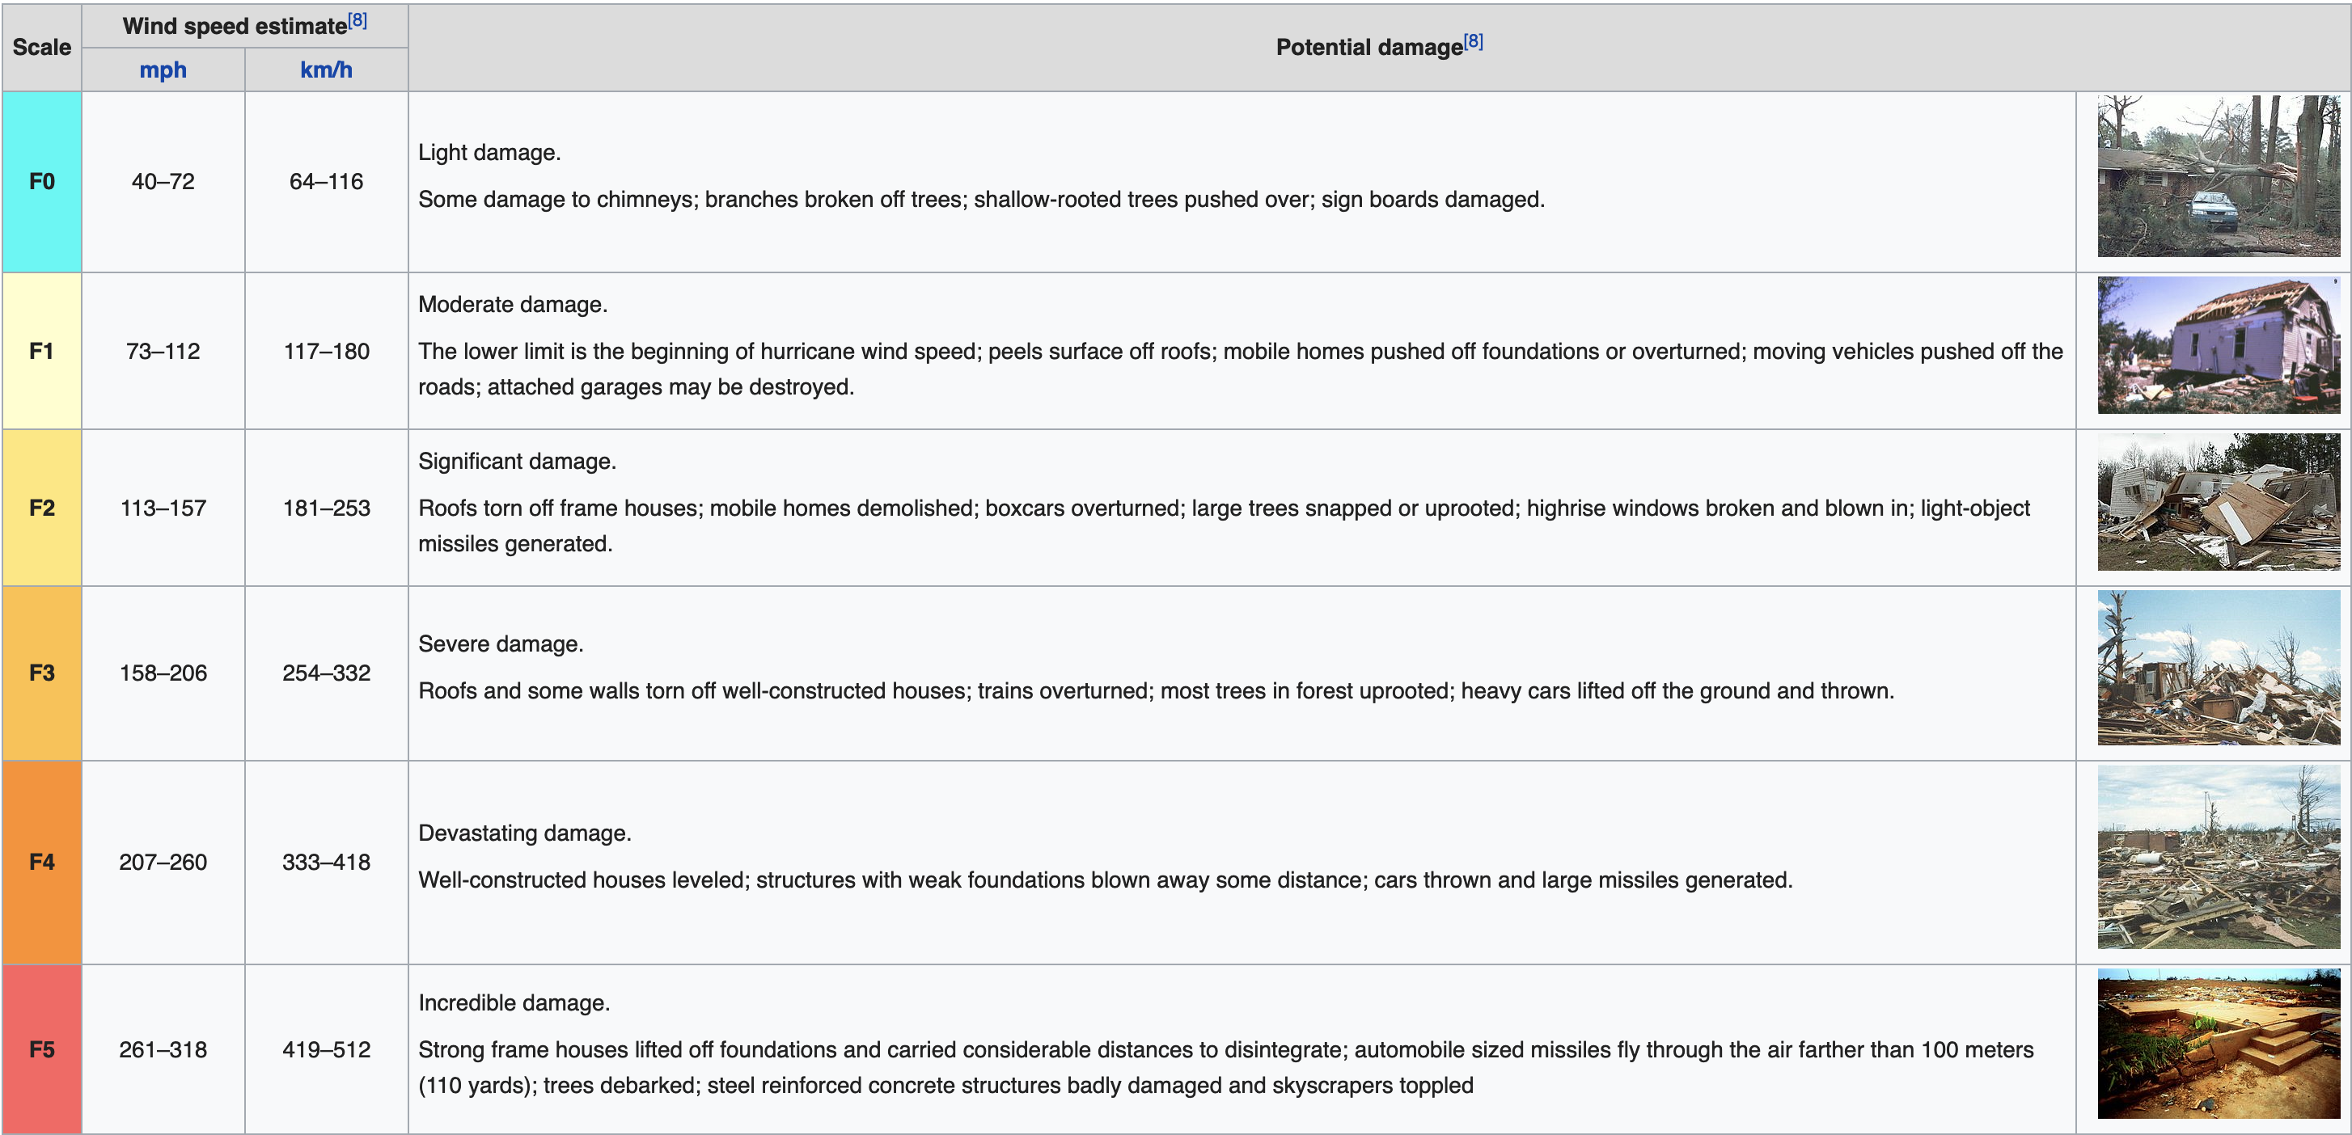
Fujita Scale
*Pulled from Wikipedia page

